Slide 1
EDA Case Study
Varsha Shastri G
Guruchetan Prabhakar
Vivek Tamrakar
Samik Bhattacharya
Submission Deadline: 25th June 2017 11:59 pm

Slide 2
Objective
Identify patterns which helps the customer finance company to reduce the risk of financial loss caused by defaulting borrowers.
Limitations
Results of the Analysis needs to be interpreted by a domain expert.
None of the team members are familiar with the domain
Our Philosophy
Perform analysis on similar to the course EDA module.
Attempt to provide insights based on our understanding.
Use R only to learn plots better

Slide 3
Approach
Data sourcing
Data cleaning
Remove columns
Univariate Analysis
Identify Relevant Columns
Bivariate Analysis
Summarize Findings
Browse CSV file
Understand Data
Manipulate String
Identify Factors/Numeric
Convert type
Understand Business
Derived Metrics
Identify Relevant Numeric Columns
Derive new columns with values based on boundaries
Create plots to visualize data
Identify and treat outliers
Identify Column pairs
Create Plots to visualize data correlation
Highlight trends
Define boundaries
Observe variations

Slide 4
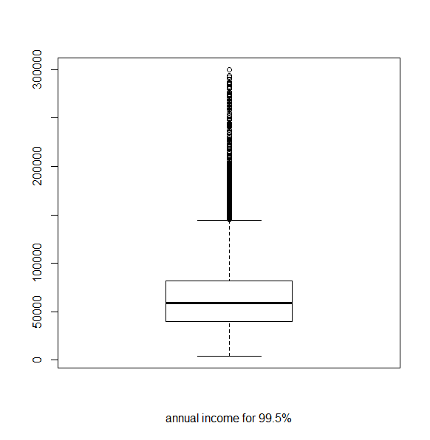
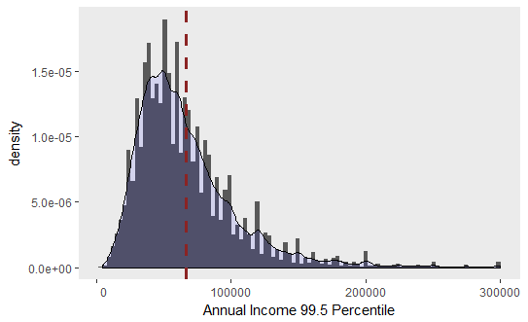
Univariate Analysis – Annual Income
Annual income is spread across a very wide range and positively skewed with a long tail.
Max value being very far from
Median is 59,000
90% of them have less than 116,000.00
95% of them have less than 142,000.00
99% of them have less than 234,999.36
99.5% of them have less than 300,000
99.9% of them have less than 676,859
The plots covering Annual Income with up to 99.5 percentile.

Slide 5
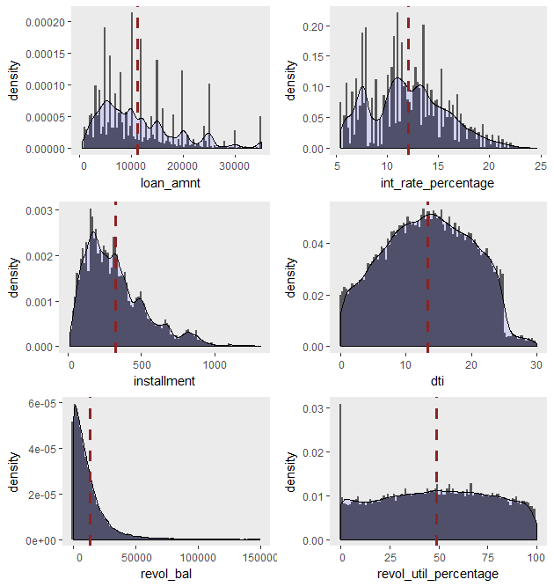
Univariate Analysis – Continuous Numeric variables
Certain bin in Loan Amount and Interest Rate show spikes indicating preferred ranges for application of loans and interest rates
Installment, dti (debt to income ratio), revol_bal (revolving balance) present a smoother histogram
* Bin width of histogram can majorly affect its jarred nature. Density curve is less affected by bin width, therefore it provides a better overview for analysis of continuous numeric values
** Red dotted line in the graphs indicate mean values

Slide 6
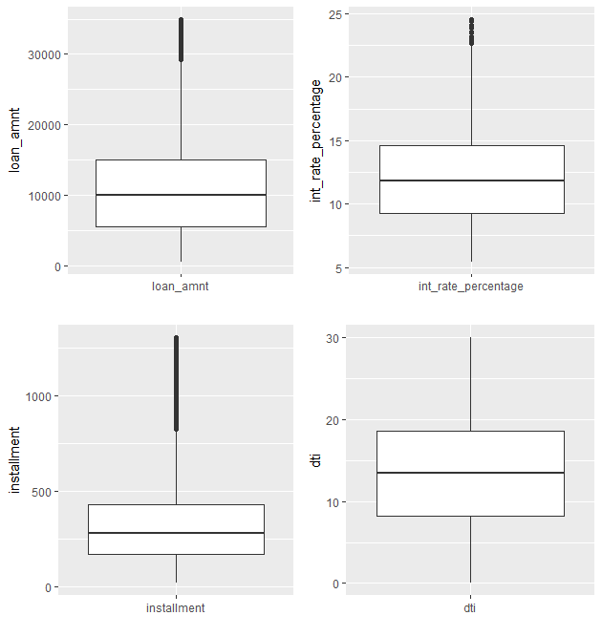
Univariate Analysis – Continuous Variables 1
Attribute Name | Max | Min | Median | IQR* | 90 % | 95 % | 99 % | 99.5 % | 99.99 %
annual_inc | 6,000,000 | 4,000 | 59,000 | 41,896 | 116,000 | 142,000 | 234,999.4 | 300,000.0 | 676,859
dti | 29.99 | 0 | 13.4 | 10.43 | 22.33 | 23.84 | 26.68 | 28.06 | 29.44
installment | 1305.19 | 15.69 | 280.22 | 263.76 | 622.95 | 762.99 | 931.54 | 1063.16 | 1229.95
int_rate_percentage | 24.59 | 5.42 | 11.86 | 5.34 | 16.89 | 18.54 | 20.99 | 21.74 | 23.13
loan_amnt | 35,000 | 500 | 10,000 | 9,500 | 22,000 | 25,000 | 35,000 | 35,000 | 35,000
There are no outlines in DTI
The range of outliers in increasing order
DTI (Debt to Income ration) - no outliers
Interest Rate (int_rate_percentage)
Loan Amount (loan_amt)
Installment
* IQR Inter Quartile Range provides a good overview of the spread

Slide 7
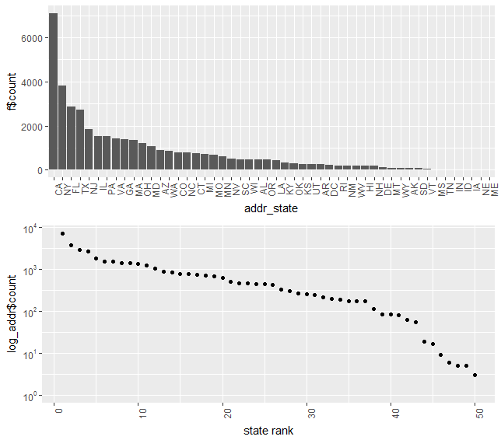
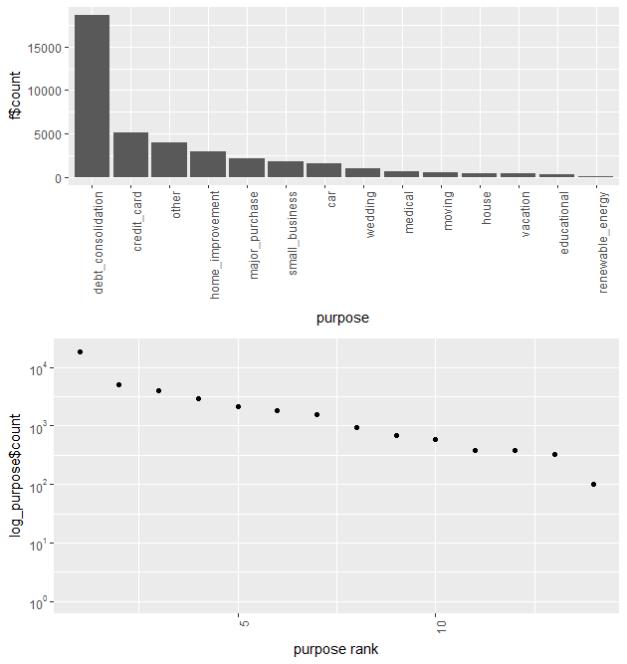
Univariate Analysis – Log plot for purpose, Address State
“Debt consolidation” is the purpose of 47% of the loans and takes up the highest number of loans in the “Purpose” category
18% of the loans are granted to clients in CA and takes up the highest number of loans in the purpose “Address State” Category
Log scale for count in “Purpose” plot shows a straight line pattern
Log scale for count in “Address State” plot shows a straight line pattern

Slide 8
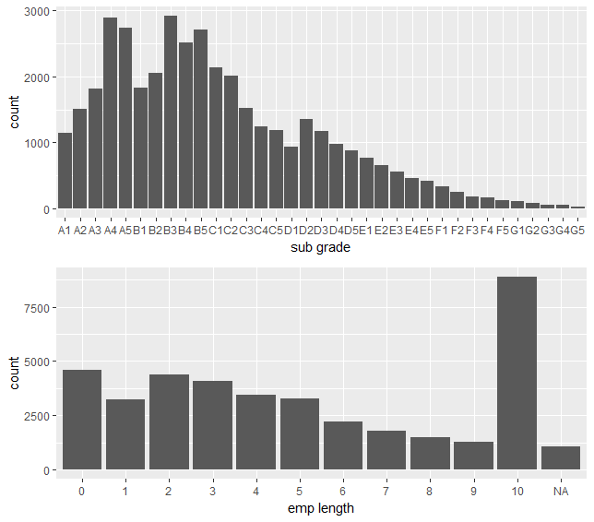
Univariate Analysis – Subgrade Employment Length Distribution
Sub Grade Graph
Clients/Members have been assigned grades which resembles a normal distribution curve.
The count for Grade B Loans is less than expected as per the normal distribution curve.
This is an indication that criteria can be reworked to make Grade B loans more lenient and Grade C loans more stringent
Employment Length
When one considers employment range upwards of 1 year and less than 10 years there seems a pattern similar to normal distribution curve.
0 which represents people with less than 1 year of employment is an anomaly. It is 4,583 in number But makes sense as persons with less than one year are more likely to apply for loans.
10 which represents people with more than 10+ years therefore the spike is justified. It is 8879 in number
Assumption: A1>A2>A3……B1>… B5……G5

Slide 9
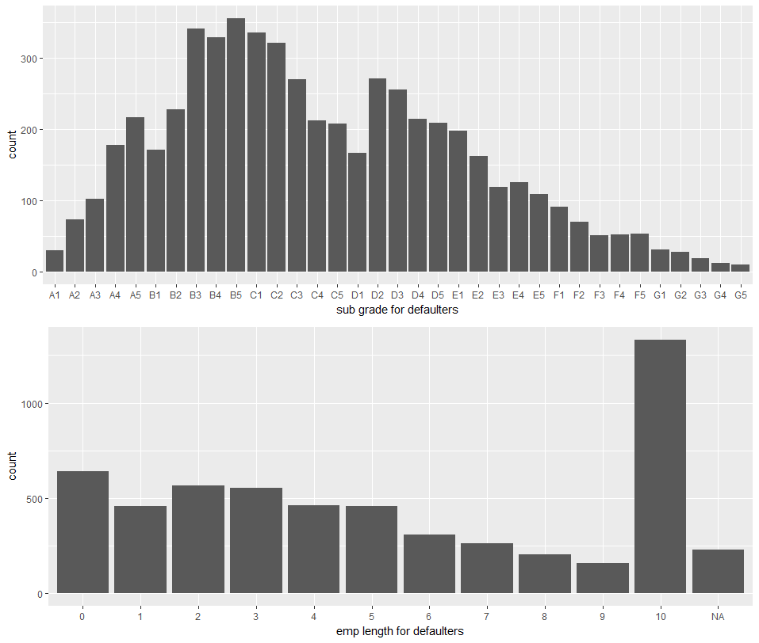
Segmented Univariate Analysis for Sub-grade and Employment Length Distribution
Sub Grade plot for Defaulters
Clients/Members have been assigned grades which resembles a normal distribution curve.
The count for Grade C Loans is less than expected. This is an indication that criteria can be reworked to be more lenient towards Category C.
Employment Length plot for Defaulters
When one considers employment range upwards of 1 year and less than 10 years there seems normal distribution curve pattern.
0 which represents people with less than 1 year of employment is an anomaly.
10 which represents people with more than 10+ years therefore the spike is justified.

Slide 10
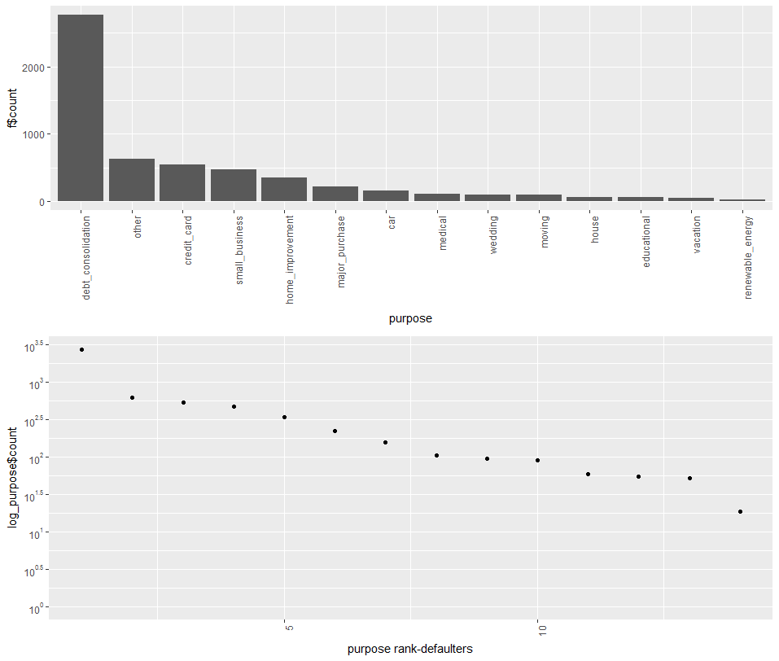
Segmented Univariate Analysis for purpose
Maximum number 2767 of defaulters for “Debt Consolidation”
When log is performed on the count it shown a pattern similar to a straight line

Slide 11
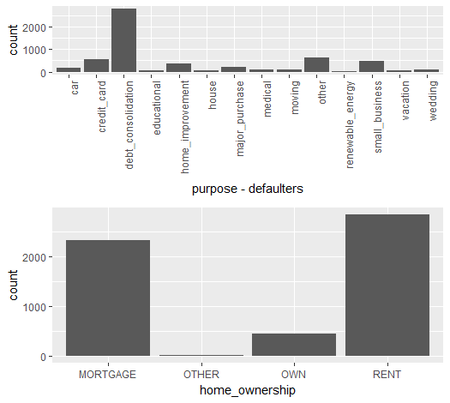
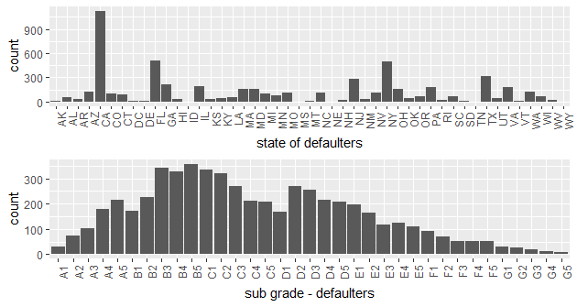
Segmented Univariate Analysis
We can see that CA is the state with maximum ‘charged off’. The count is 1125.
We can see a lot of ‘charged off’ in B grade. 1425 in number
Highest number of charged off loans are from the “RENT” category of home ownership. It is 2839 in number

Slide 12
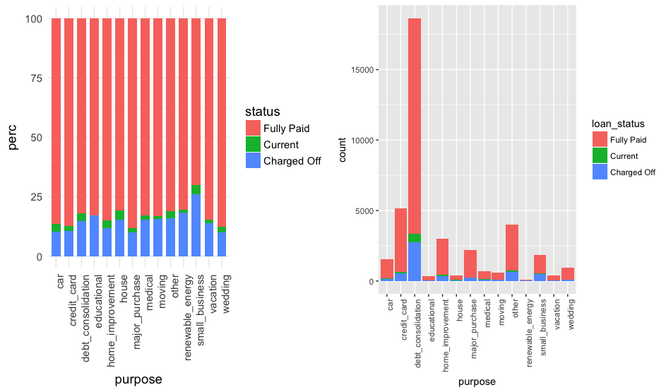
Bivariate Analysis for Purpose v/s Loan Status
Even though “Debt Consolidation” seems the most popular purpose, the highest percentage of defaulters are with the stated purpose as “small business”
A tighter criteria for loan approval can be considered for purpose with “small business”

Slide 13
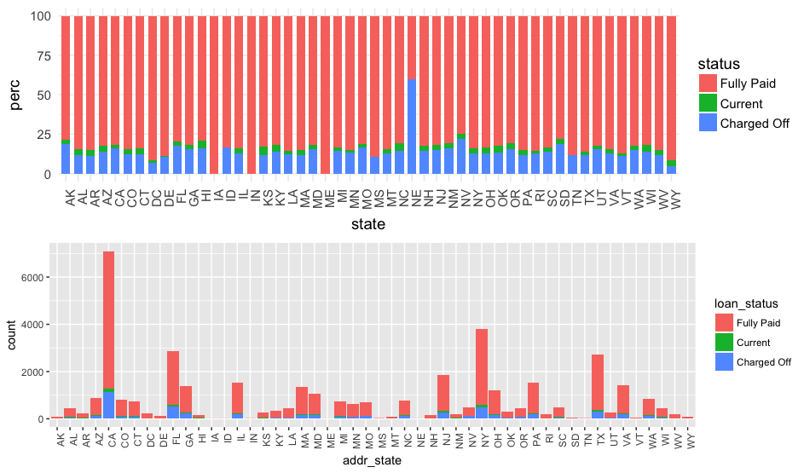
Bivariate Analysis for Address State vs Loan Status
Though NE seems to be high on the percentage scale for defaulters, the number of loans/clients from NE is very small therefore ignore NE for Analysis

Slide 14
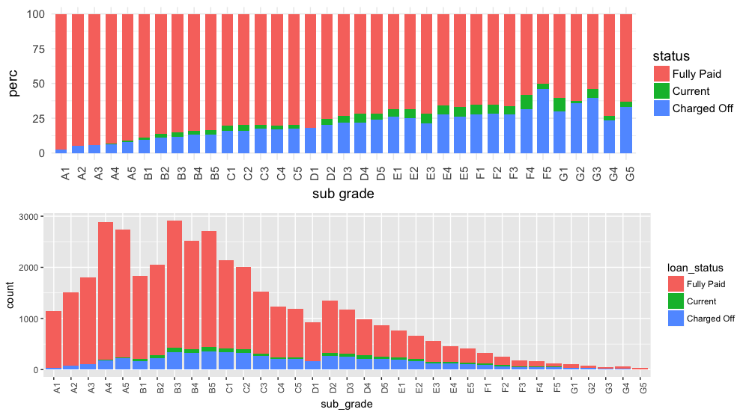
Bivariate Analysis for Subgrade v/s Loan Status
We can see that CA is the state with maximum charged off. But we can make the conclusions only based on percentage.
We can see a lot of charged off in debt consolidation but we need to see percentage to make final conclusion
We can see a lot of charged off in B grade but we need to see percentage to make final conclusion.

Slide 15
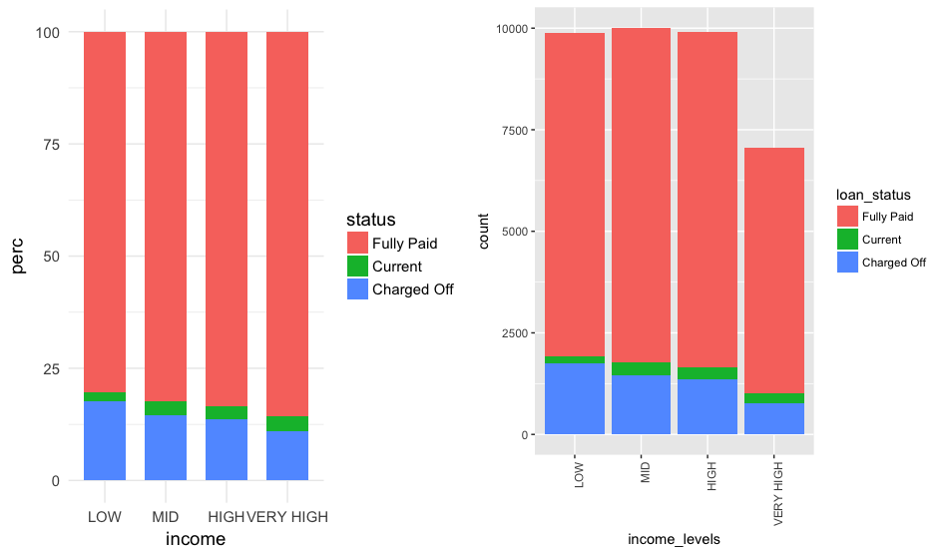
Bivariate Analysis for Income Levels v/s Loan Status
We can see that CA is the state with maximum charged off. But we can make the conclusions only based on percentage.
We can see a lot of charged off in debt consolidation but we need to see percentage to make final conclusion
We can see a lot of charged off in B grade but we need to see percentage to make final conclusion
#There are very high number of rental properties.

Slide 16
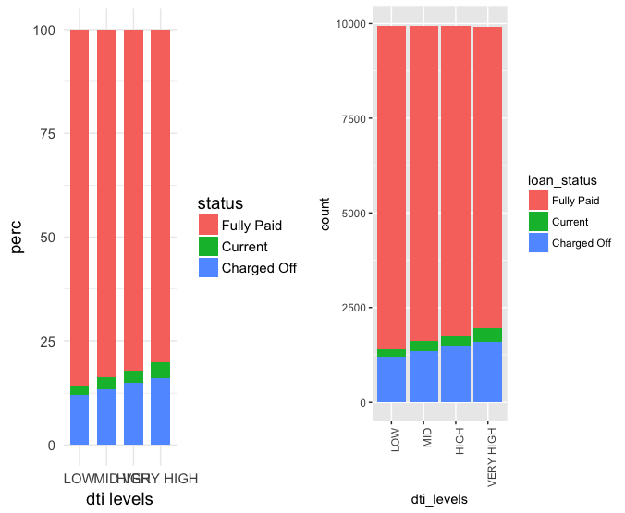
Bivariate Analysis for DTI Levels v/s Loan Status
We can see that CA is the state with maximum charged off. But we can make the conclusions only based on percentage.
We can see a lot of charged off in debt consolidation but we need to see percentage to make final conclusion
We can see a lot of charged off in B grade but we need to see percentage to make final conclusion
#There are very high number of rental properties.

Slide 17
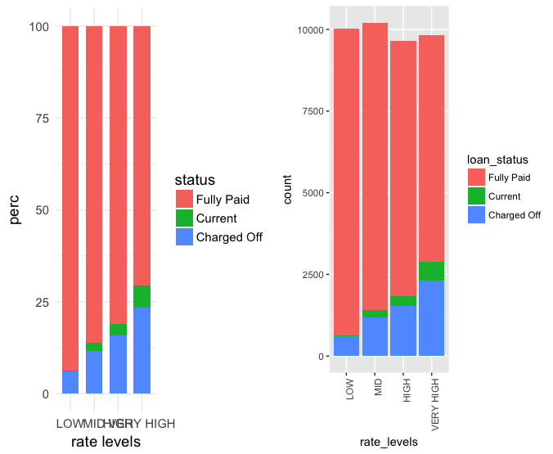
Bivariate Analysis for Interest Rate Levels v/s Loan Status
We can see that CA is the state with maximum charged off. But we can make the conclusions only based on percentage.
We can see a lot of charged off in debt consolidation but we need to see percentage to make final conclusion
We can see a lot of charged off in B grade but we need to see percentage to make final conclusion
#There are very high number of rental properties.

Slide 18
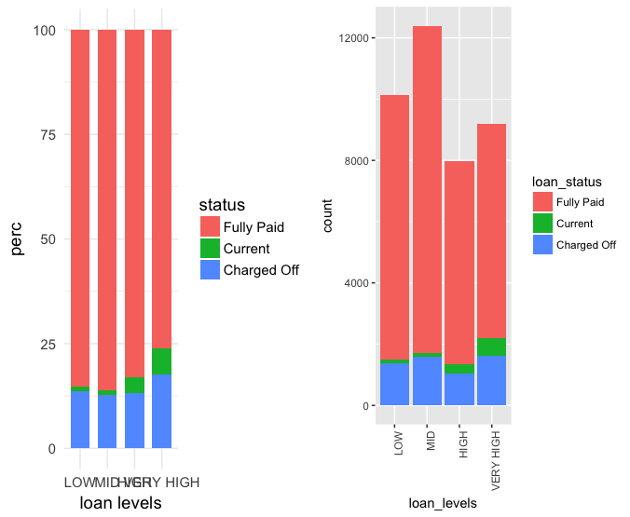
Bivariate Analysis for Loan Amount Levels v/s Loan Status
We can see that CA is the state with maximum charged off. But we can make the conclusions only based on percentage.
We can see a lot of charged off in debt consolidation but we need to see percentage to make final conclusion
We can see a lot of charged off in B grade but we need to see percentage to make final conclusion
#There are very high number of rental properties.

Slide 19
Bivariate Analysis for Income Levels v/s Loan Status
We can see that CA is the state with maximum charged off. But we can make the conclusions only based on percentage.
We can see a lot of charged off in debt consolidation but we need to see percentage to make final conclusion
We can see a lot of charged off in B grade but we need to see percentage to make final conclusion
#There are very high number of rental properties.

Slide 20
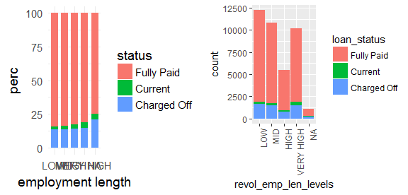
Bivariate Analysis for Employment Len Levels
Categories for Employment Length
Low: >1,1,2
Mid: 3,4,5
High: 6,7,8
Very High: 9,10+
There seems a trend that higher the employment length greater is the likely hood of default.

Slide 21
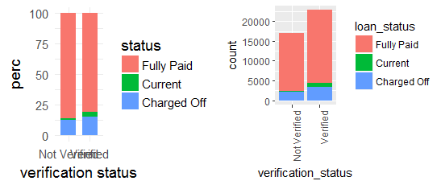
Bivariate Analysis for Verification Status v/s Loan Status
Higher percentage of Current in Verified indicates that Verification is being done for a great proportion
Though Verified, % of “Charged off” is higher than Not Verified.
Re-evaluation of the verification process is recommended.

Slide 22
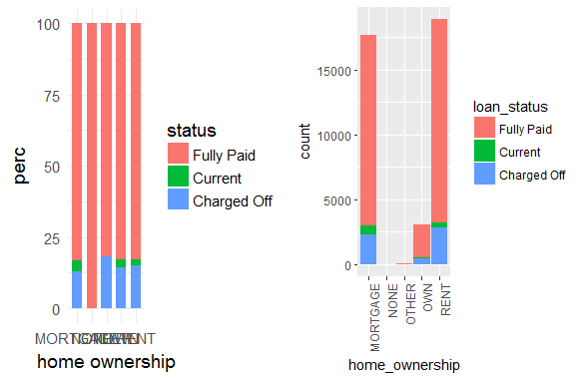
Bivariate Analysis for Home ownership v/s Loan Status
Though “None” Category seems completely “Fully Paid” the number of loans is negligible. Therefore ignore “None” Category
Ignore “Other” category also for the similar reason
But no significant difference in ratio for the other categories namely mortgage, own and rent

Slide 23
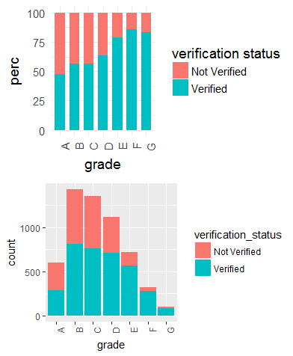
Bivariate Analysis for Grade v/s Verification Status
The trends suggests that, the count decrease from Grade B.
Also with the Grade getting lower, more proportion of the loans are verified.

Slide 24
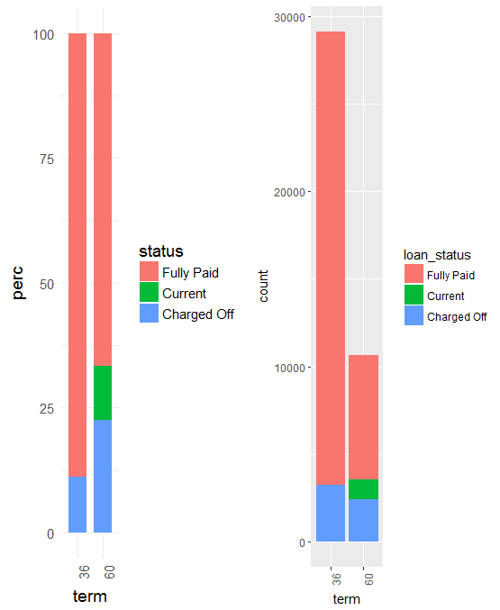
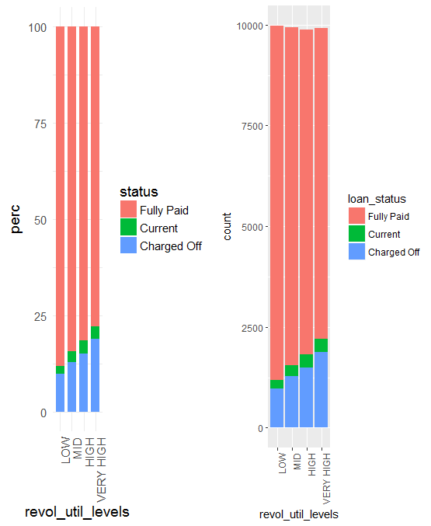
Bivariate Analysis for Term and Revol Util v/s Loan Status
Higher percentage of current loans is for 60 months term.
60 month term loans having higher Charged Off rates, the company can consider making the 36 month term loans more attractive.
The Revol_util_levels graphs confirm higher Charged Off chances for higher values of “revol_util_levels”

Slide 25
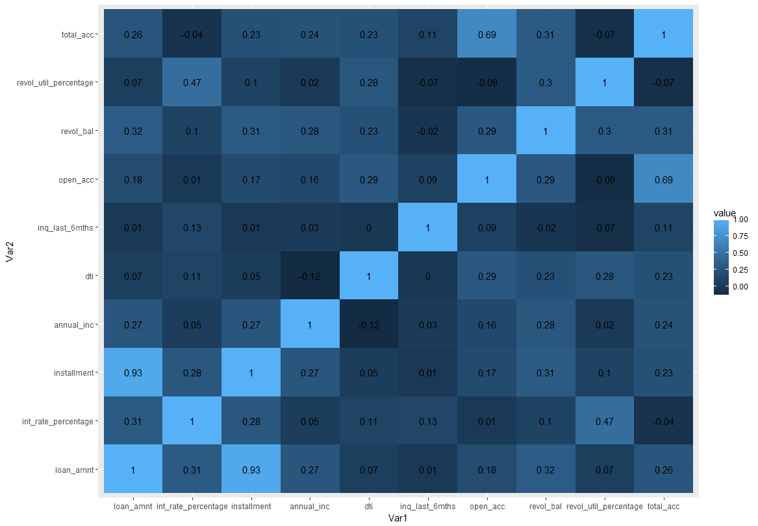
Bivariate Analysis Correlation Matrix
Cont Var 1 | Cont Var 1 | Correlation Degree
dti | annual_inc | -0.12
annual_inc | dti | -0.12
revol_util_percentage | open_acc | -0.09
open_acc | revol_util_percentage | -0.09
revol_util_percentage | inq_last_6mths | -0.07
inq_last_6mths | revol_util_percentage | -0.07
total_acc | revol_util_percentage | -0.07
revol_util_percentage | total_acc | -0.0
No significant Correlation between any of the Continuous Numeric Variables.

Slide 26
Conclusion
Driver variables which lead to more chance of defaulting - not in this order though:
Higher dti levels
Higher revol util percentage
Higher loan levels
Higher interest rate levels
Lower annual income
Source verification: Verified source tends to default more.
When we analyse grades and verification source, we see that as grades increase(from A to G), the verified sources tend to default more than unverified source. This clearly shows there is an issue with the verification process.
Purpose:
When we go by total number of defaulters instead of percentage, debt consolidation seems like a bigger driver however when we see percentages we see small business has highest percentage of defaulters.
Address state:
At first look, when we analyse only the numbers and not percentage of defaulters, address state being CA-california is a driver to some extent however, since the number of loans from CA are high too, the percentage of defaulters in that region is not too high
Term:
Longer term shows higher percentage of defaulters.

